Slide 1

FRANCHISE DATA
Dec 17th, 2022

Slide 2


About Us
Peratla Sujith (B Tech)
4 years of working experience in Verizon as a Java developer
Knowledge in requirement analysis, development and deploying apps
Fascinated with Computer vision & Natural Language Processing usage in the market today
E mail ID : sujithperatla@gmail.com
Contact : +91-9160323462
Jai Bharath Reddy Chalava (MBA)
Completed MBA Finance in 2022
Knowledge in C & Tally technologies
Learn Data Science for career opportunities
E mail ID : bharathchalava@gmail.com
Contact : +91-6304881088

Slide 3
Agenda
Objective & Problem Statement
Why Franchise India ?
Architecture
Data Collection
Data Extraction
Data Cleaning
Data Visualization
Conclusion
Q & A

Slide 4
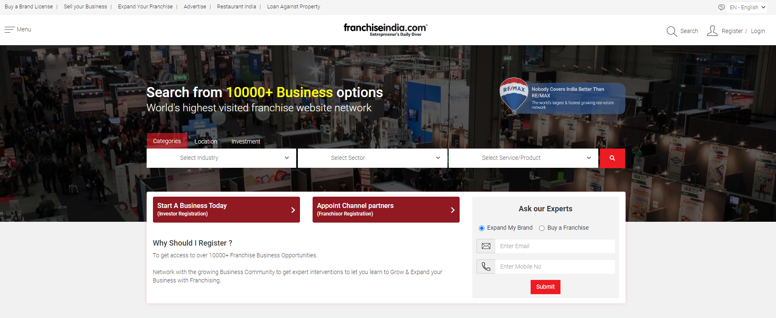
Objective & Problem Statement
With a lot of Companies in India, it is very difficult to choose an ideal company to invest. This project will analyse different franchises based on several factors like - Location, Category, Space, Amount & Time period etc to identify an optimal
So our main goal is provide a easy solution to the end user. As part of our analysis, we web scraped data from “https://www.franchiseindia.com/” website and fetched 650 records in total

Slide 5
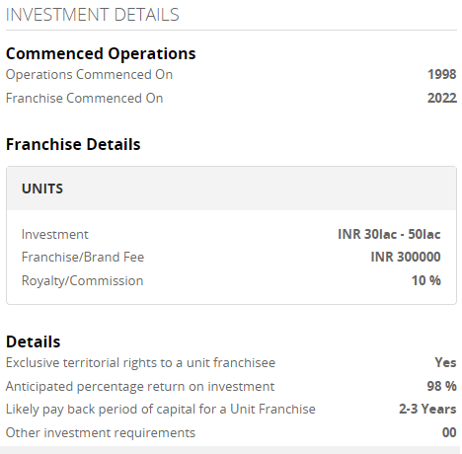
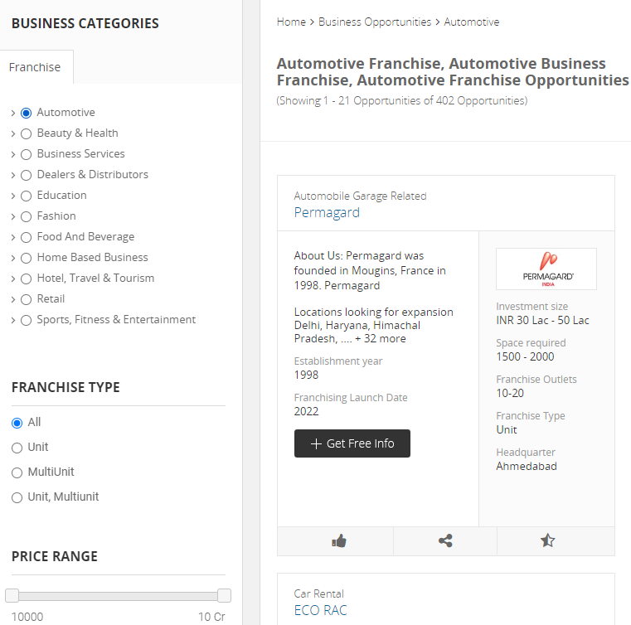
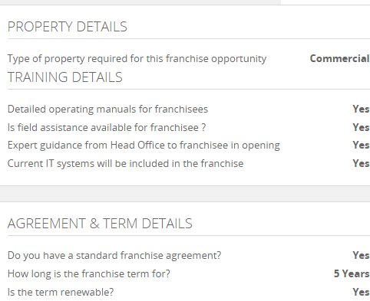
Why Franchise India ?
As Entrepreneurship and franchising have become an increasingly viable business ownership opportunity, several prospective business owners and entrepreneurs from throughout India are looking for a platform to kickstart their business
FranchiseIndia is a one of its kind platform for startups and entrepreneurs to scout for business opportunities, franchise partners and investors from across the country. This forum has played a crucial role in boosting the development of the Indian franchise marketplace from ground zero to a 100 Billion dollar Industry over the past 20 years
Gaurav Marya (Chairman, Franchise India Holdings Ltd.)

Slide 6







Architecture
Data Collection
Perform Web Scraping - Data Extraction
Fetch from the website
Create DataFrame & clean data
Perform Visualization

Slide 7
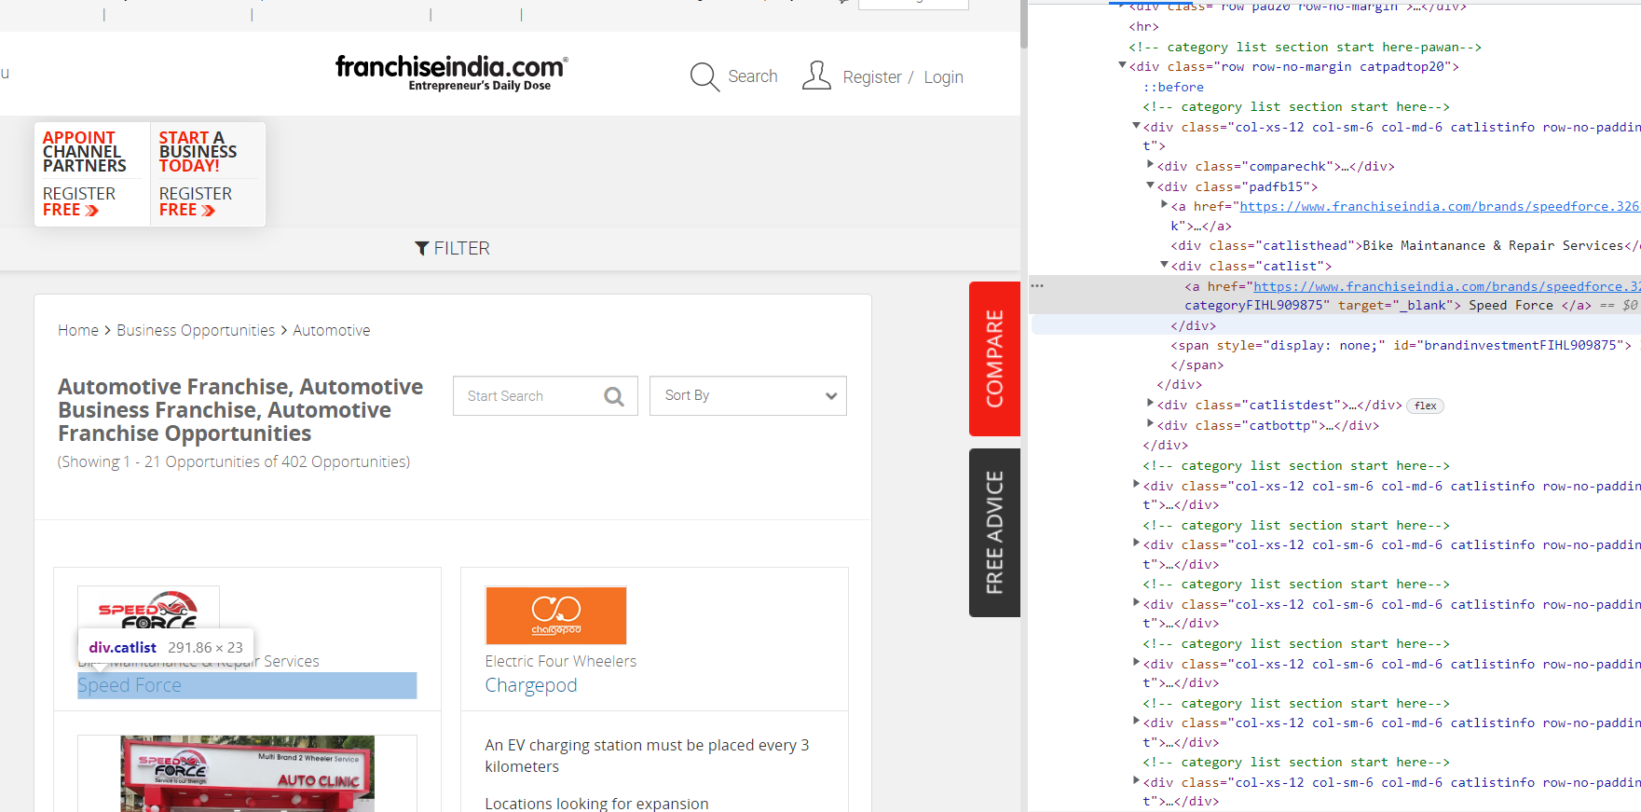
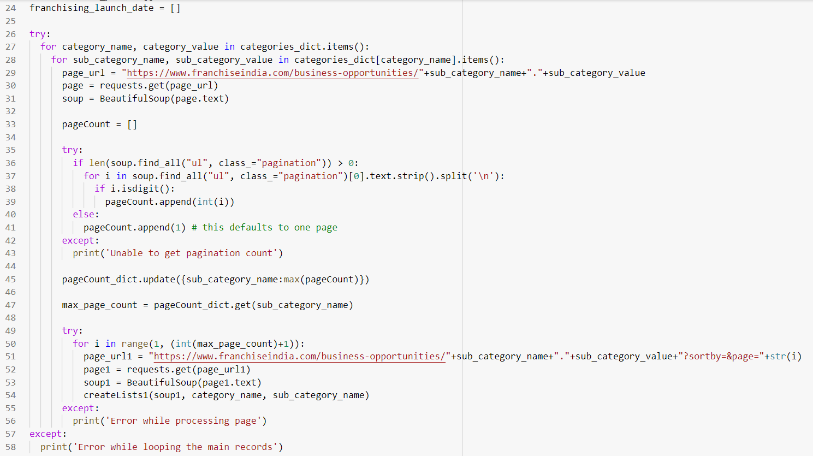
Data Collection

Slide 8
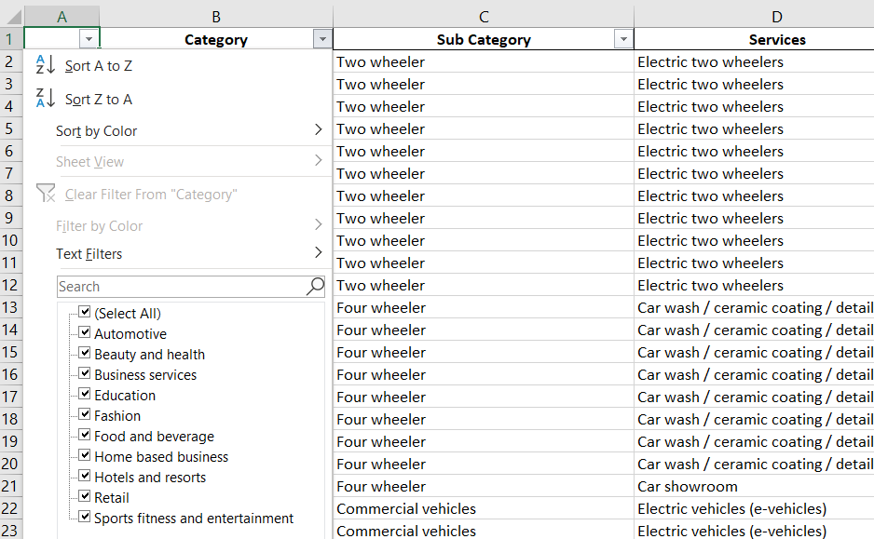
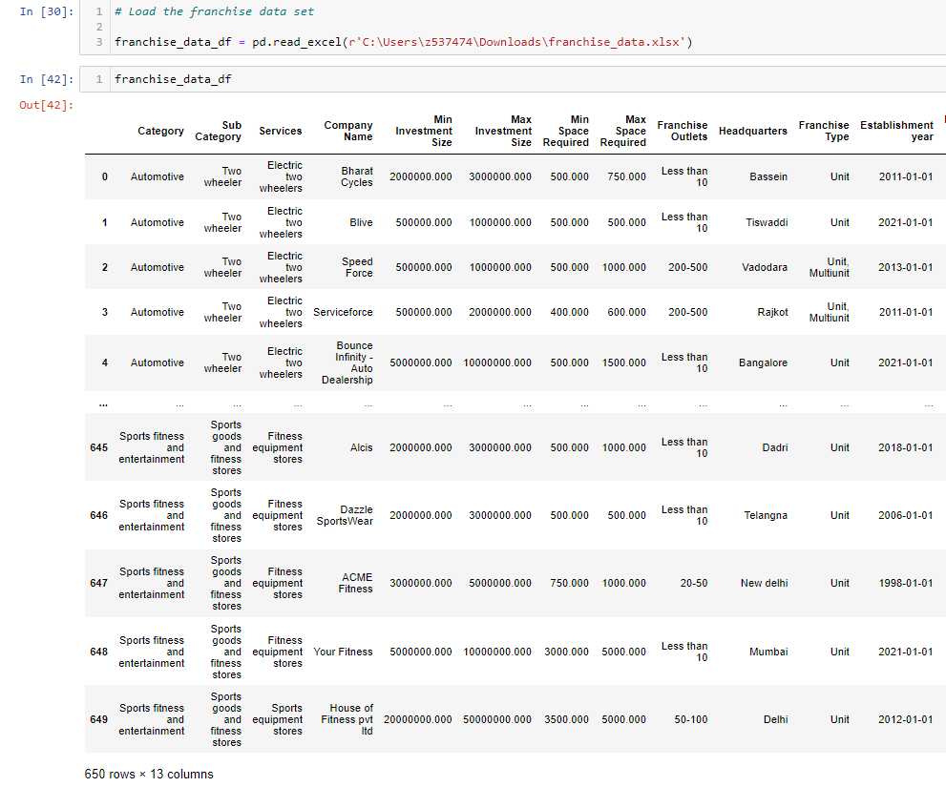
Data Extraction

Slide 9
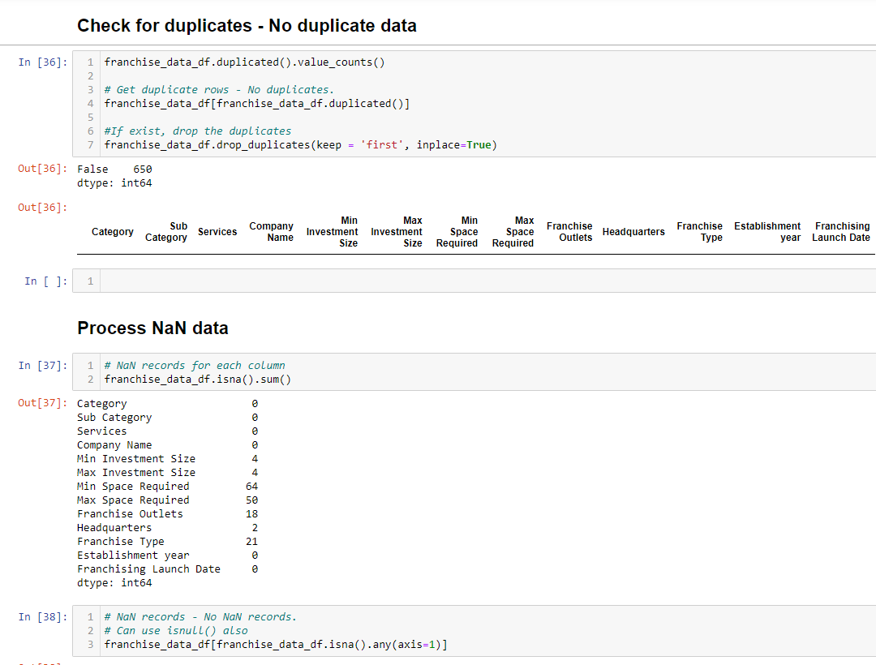
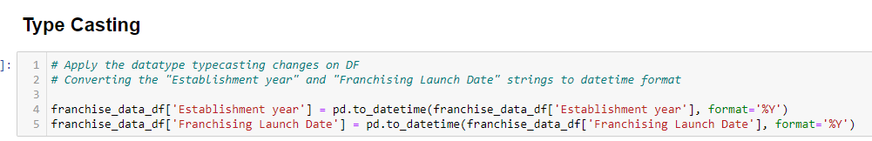
Data Cleaning
Removed unnecessary columns
Checked for Duplicates
Removed Spaces
Removed Zeros
Removed NaN records
Data Type conversion
Outliers removal*

Slide 10
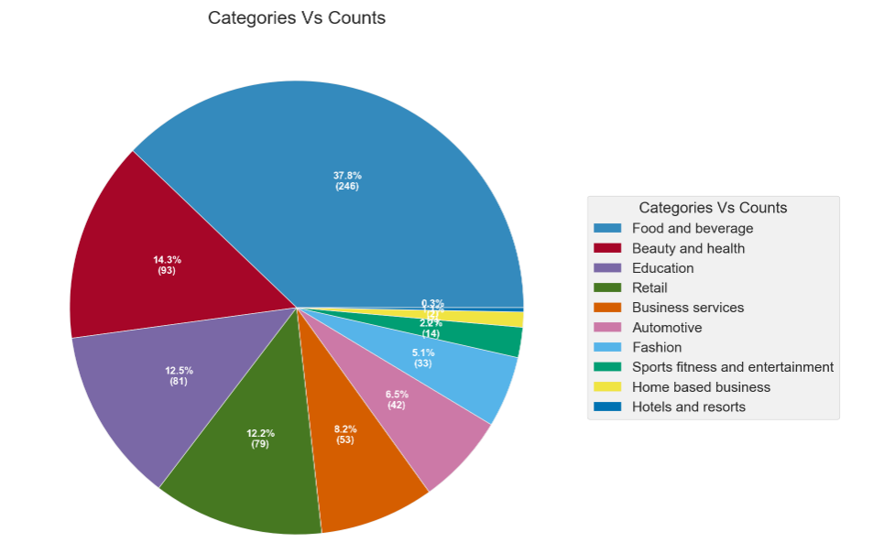
Data Visualization
Univariate Analysis -
Unique set of "Category" combinations : 10
Unique set of "Category & Sub Category" combinations : 48
Unique set of "Category, Sub Category & Services" combinations : 74
Observation : Out of 650 Companies, 37.8% (246 records) belong to "Food and beverage" category

Slide 11
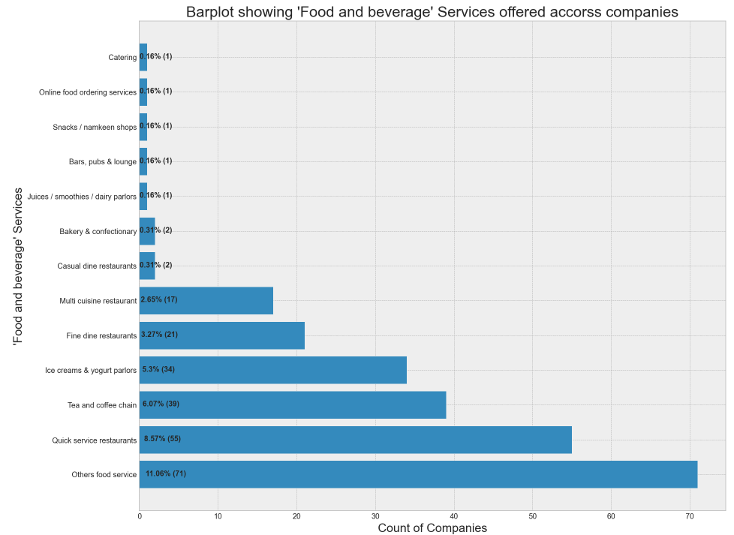
Univariate Analysis -
‘Food and beverage’ Services | Count
Others food service | 71
Quick service restaurants | 55
Tea and coffee chain | 39
Ice creams & yogurt parlors | 34
Fine dine restaurants | 21
Multi cuisine restaurant | 17
Casual dine restaurants | 2
Bakery & confectionary | 2
Juices / smoothies / dairy parlors | 1
Bars, pubs & lounge | 1
Snacks / namkeen shops | 1
Online food ordering services | 1
Catering | 1
Observation : Out of 37.8% (246 records) from "Food and beverage" category, 'Others food service' Service has a major share of 11.06% (71 records)

Slide 12
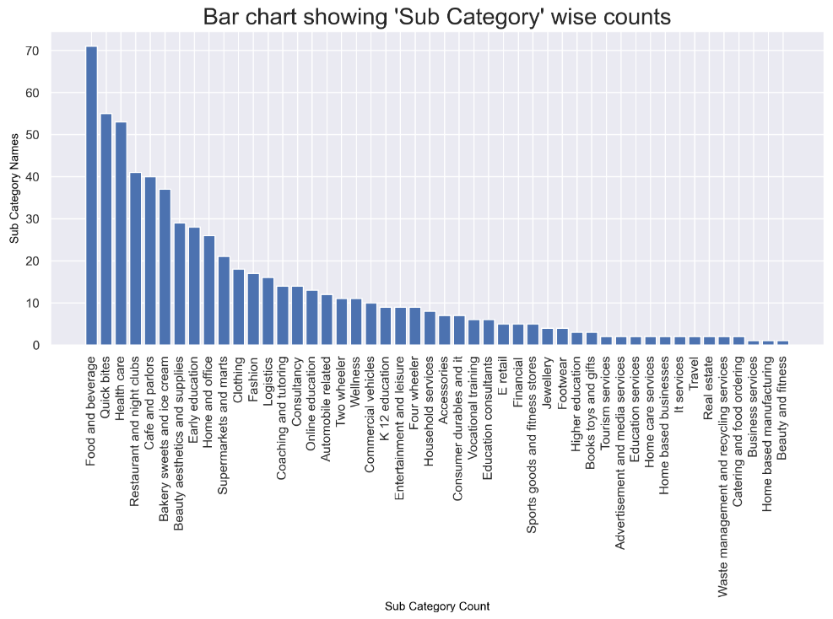
Univariate Analysis -
Sub Categories | Count
Food and beverage | 71
Quick bites | 55
Health care | 53
Restaurant and nightclubs | 41
Cafe and parlors | 40
Bakery sweets and ice cream | 37
Beauty aesthetics and supplies | 29
Early education | 28
Home and office | 26
Supermarkets and marts | 21
Supermarkets and marts | 21
Observation : Observation : Out of 48 ‘Sub Categories’, ‘Food and beverage’ has a great scope of investing

Slide 13
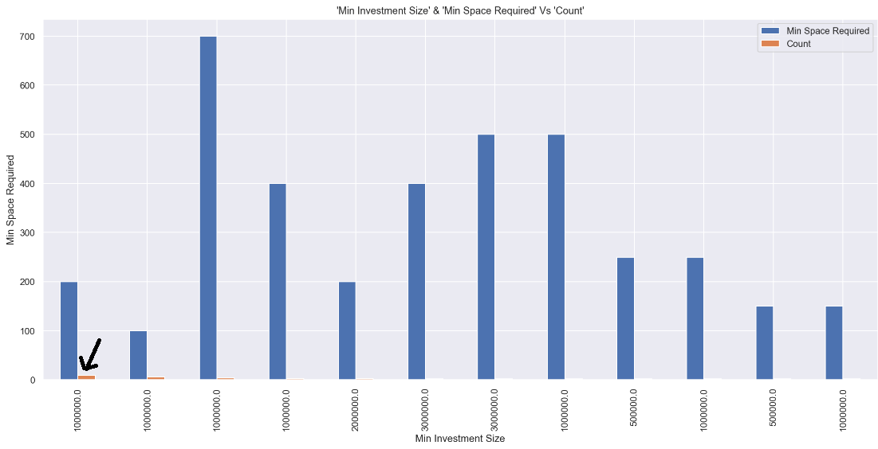
Univariate Analysis -
Min Space Required | Min Investment Size | Count
200 | 1000000 | 9
100 | 1000000 | 6
700 | 1000000 | 4
400 | 1000000 | 3
200 | 2000000 | 3
400 | 3000000 | 2
500 | 3000000 | 2
500 | 1000000 | 2
250 | 500000 | 2
250 | 1000000 | 2
150 | 500000 | 2
150 | 1000000 | 2
Observation : Out of 11.06% (71 records), 9 companies were set up with a minimum investment of 10 Lakhs. Also to open such Franchise, we need a minimum of 200 Sf. Ft.

Slide 14
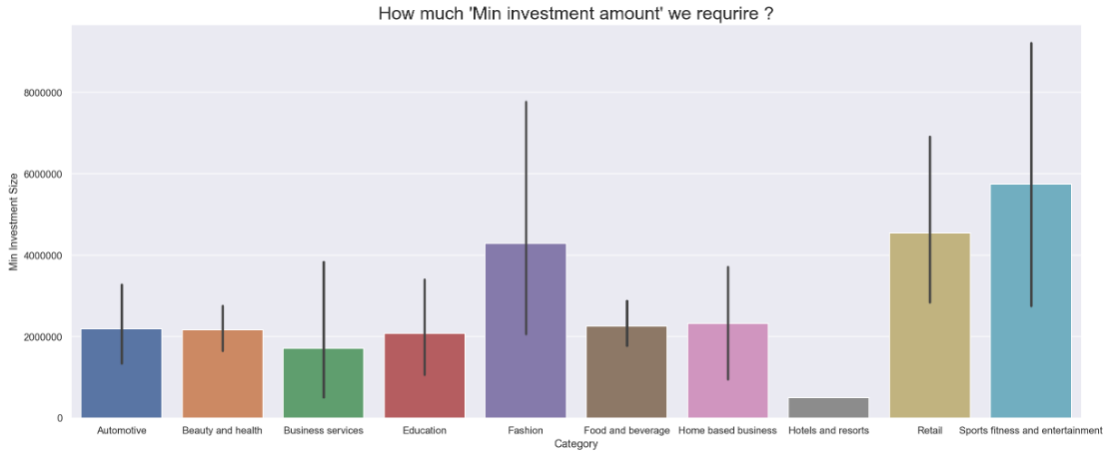
Univariate Analysis -
Observation :
‘Sports fitness and entertainment’ require more investment compared to other categories.
Minimum investment starts at 10,000 INR & goes till 5 Cr

Slide 15
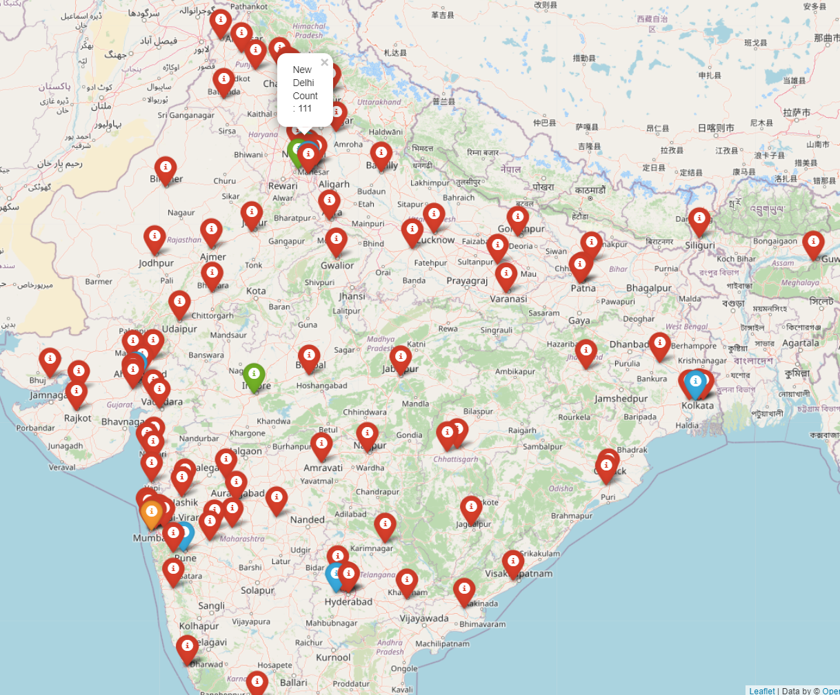
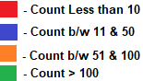
Univariate Analysis -
Headquarters | Count
New Delhi | 114
Mumbai | 68
Gurugram | 49
Faridabad | 41
Bengaluru | 40
Ahmedabad | 34
Pune | 21
Hyderabad | 21
Haveli | 13
Kolkata | 12
Indore | 10
Note - Data generated using Google Maps GeoCoding APIs, OpenStreetMap & folium
Observation : There are more franchise opportunities for companies whose headquarters is located in ‘New Delhi’ (17%) i.e, Count = 111

Slide 16
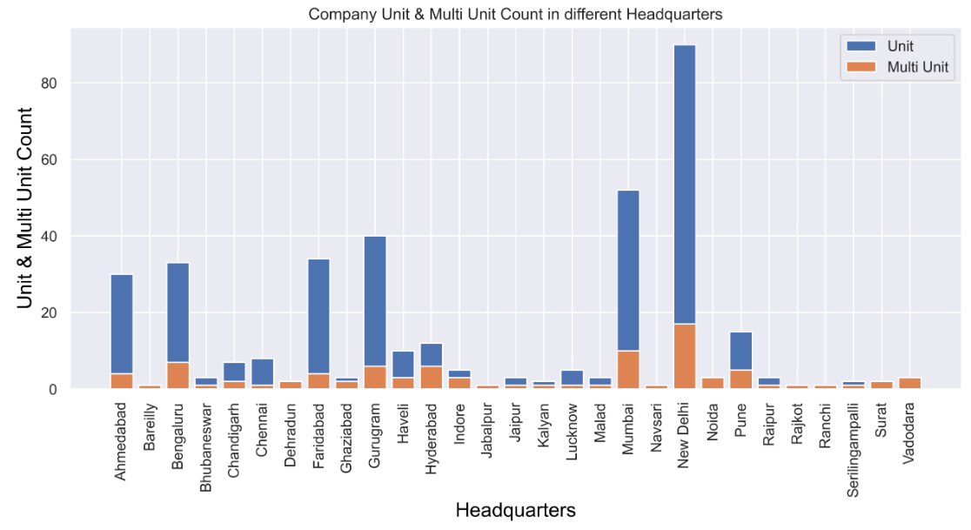
Bivariate Analysis -
Observation : ‘New Delhi’ has more opportunities to open regular Units or “Multi Units” for Franchising, compared to other Cities

Slide 17
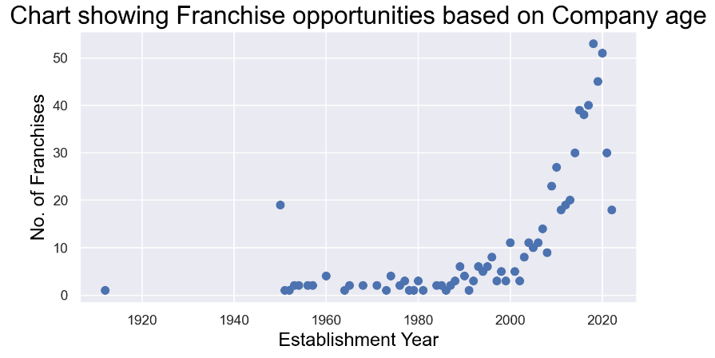
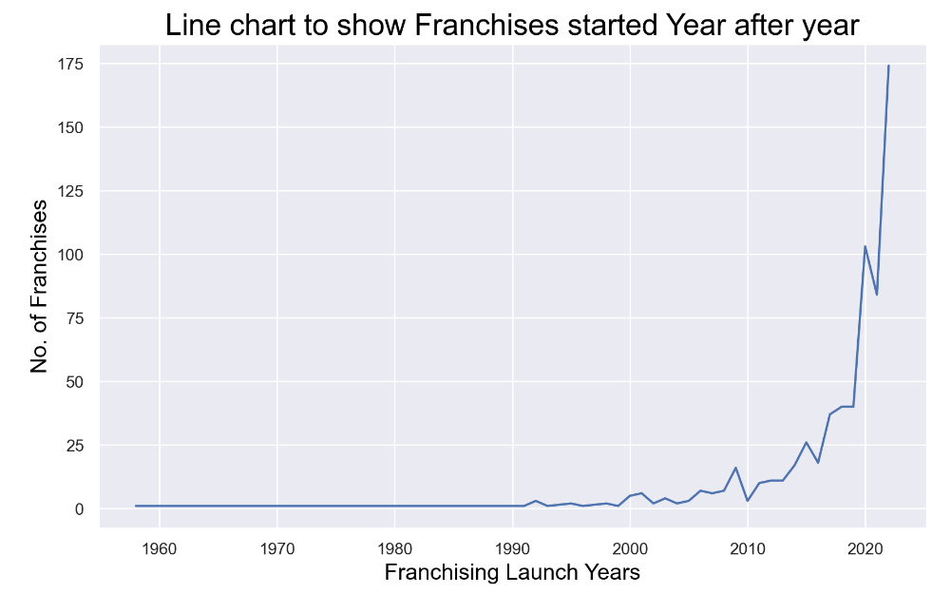
Univariate Analysis -
Observation :
Companies established in 2020 see good franchise opportunities compared to older companies
Similarly, More Franchise opportunities/Dealerships started from 2020 onwards

Slide 18
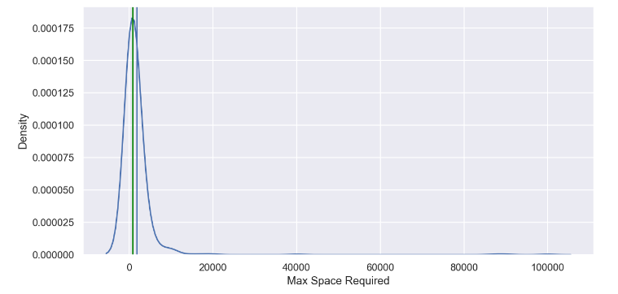
Univariate Analysis -
Observation : Majority of the Companies need a space b/w 200 to 2000 Sf. Ft. This should be considered while planning to go for franchising
Mean - 1862 | Median - 800

Slide 19
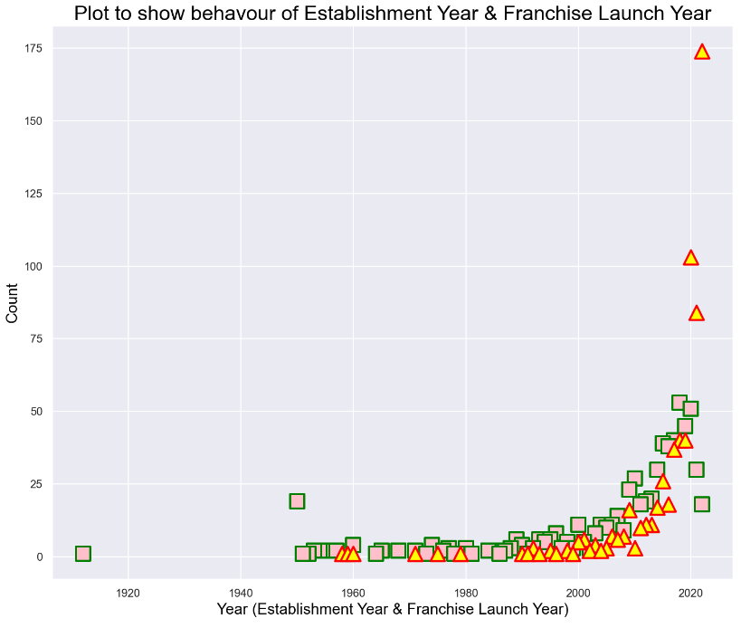
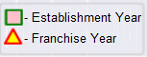
Bivariate Analysis -
Establishment Year | Count | Franchise Launch Year | Count
2018 | 53 | 2022 | 174
2020 | 51 | 2020 | 103
2019 | 45 | 2021 | 84
2017 | 40 | 2018 | 40
2015 | 39 | 2019 | 40
2016 | 38 | 2017 | 37
2014 | 30 | 2015 | 26
2021 | 30 | 2016 | 18
2010 | 27 | 2014 | 17
2009 | 23 | 2009 | 16
2013 | 20 | 2013 | 11
1950 | 19 | 2012 | 11
Observation :
There are more opportunities to start a franchise in the companies which were established in the last 10 years
Many companies started franchising in the last 5 years

Slide 20
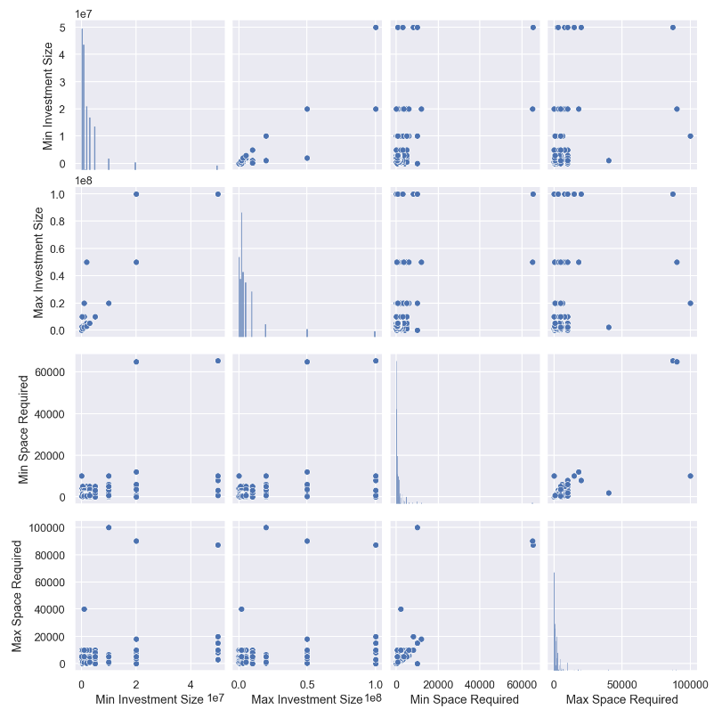
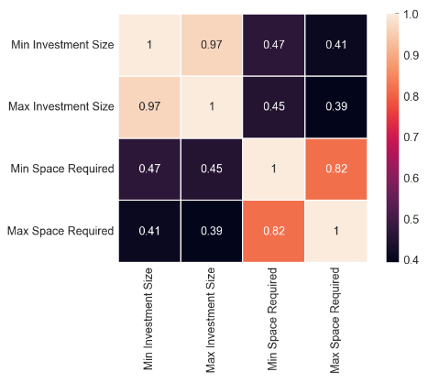
Multivariate Analysis -
Observation :
From this graph, we see that the ‘Minimum Space Required’ is related to ‘Minimum Investment Size’
Investment Amount and Space are positively correlated
“Investment Amount” and “Space Required” are directly related to each other

Slide 21
Conclusion
Experience with the Project
Code available at Github - https://github.com/sujithperatla/Python-EDA-Project
More scope of Investment in Food Industry
Can start investing in Companies whose Headquarters are in ‘New Delhi’
Need to consider the “Sub Category” & Sector as well
“Establishment Year” and “Franchising Launch Year” show a positive sign in the last 5 to 10 years
“Investment Amount” and “Space Required” are directly related to each other
Able to collaborate more with peers
Understand more on the different domains/industries where Data Analysis is used
Could correlate with real-time problem statements
Understand the core Python libraries & uses

Slide 22

Q & A

